Slide 1
CPU Simulator in Assembly Language and C++
Computer Organization and Assembly Language

Slide 2
Table of contents
01
02
04
05
03
Introduction
Project Overview
Key Components
06
Instruction Execution
Integration and Execution
Demonstration
07
Conclusion

Slide 3
01
Introduction
"Understanding the foundational aspects of our CPU simulator project."

Slide 4
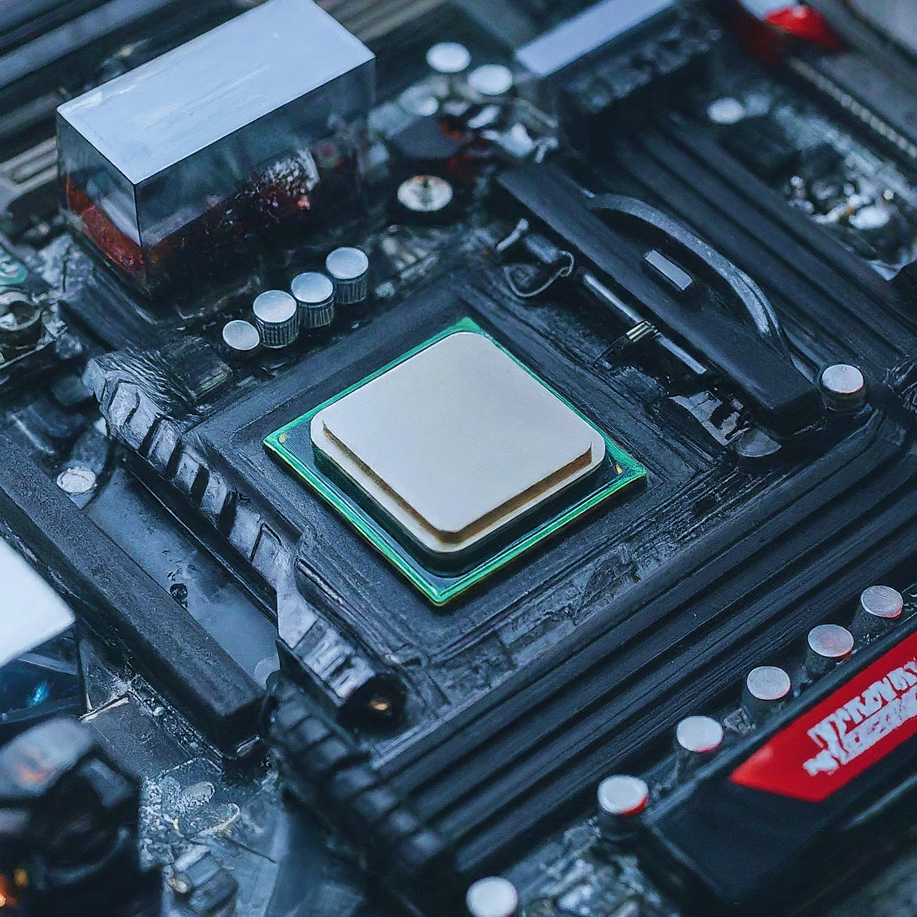
Introduction to CPU Architecture
The CPU (Central Processing Unit) is the brain of a computer, responsible for executing instructions.
It fetches, decodes, and executes instructions from programs.
Other critical components include:
Memory: Stores data and instructions for the CPU to access.
Registers: Hold temporary data used during instruction execution.
I/O Devices: Facilitate communication with external world (keyboard, monitor, etc.).

Slide 5
</ Building a Simulated CPU
The CPU simulator is designed to emulate basic CPU operations, allowing for the execution of simple programs written in assembly language.
Emulation Scope:
The simulator replicates essential CPU functionalities, enabling the execution of assembly language programs.
It provides a platform to study and simulate LOAD, STORE, ADD, and SUB operations, mimicking a real CPU's behavior.
Technological Foundation:
Developed using C++ for high-level control and assembly language (NASM) for low-level operations.
Integration ensures seamless execution of assembly instructions within the simulated environment.

Slide 6
</ Development Environment
Environment used:
Visual Studio Code (VS Code): Used as the Integrated Development Environment (IDE) for editing and managing the project files.
Ubuntu on Windows Subsystem for Linux (WSL): Provided a Linux environment for testing and debugging the CPU simulator project.
Compiler and Assembler:
C++ Compilation: “g++ -m32” used to compile cpu_simulator.cpp.
Assembly Compilation: “nasm -f elf32” used to assemble cpu_functions.asm.
Integration: Linked both compiled objects using “g++ -m32” to create the executable cpu_simulator.
} /> [

Slide 7
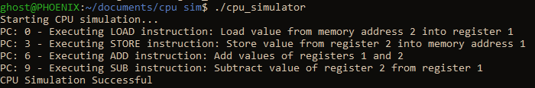
</ Output
Compilation Commands:
nasm -f elf32 cpu_functions.asm -o cpu_functions.o
g++ -m32 -c cpu_simulator.cpp -o cpu_simulator.o
g++ -m32 cpu_simulator.o cpu_functions.o -o cpu_simulator
Execution Output:
Upon running “./cpu_simulator”
/>

Slide 8
Project Overview
02
"Exploring the structure and functionality of our CPU simulator files."

Slide 9
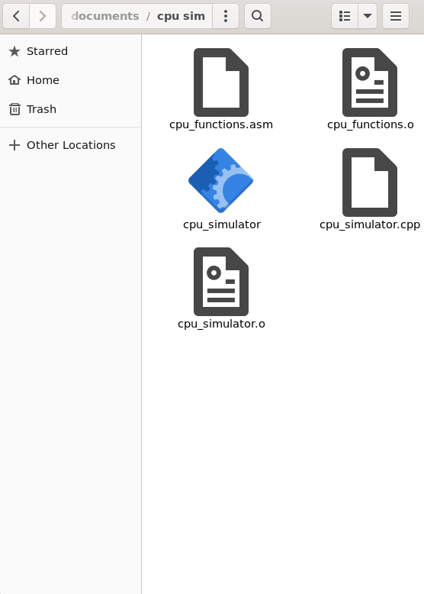
Project Overview
In this project, we have developed a CPU simulator to emulate basic CPU operations using a combination of C++ and assembly language.
The simulator consists of two key files that work together to achieve this emulation:
cpu_simulator.cpp:
Serves as the main driver for the CPU simulator.
Manages program execution flow, memory operations, and interaction with user-defined assembly functions.
cpu_functions.asm:
Implements core operations in assembly language.
Defines functions for memory manipulation and arithmetic operations critical to the CPU simulator's functionality.

Slide 10
</ Overview of cpu_simulator.cpp:
Role:
Acts as the main driver of the CPU simulator.
Responsible for loading the program into memory and executing instructions.
Key Components:
Program Counter (PC): Tracks the current instruction being executed.
Memory Array: Simulates the main memory of the CPU.
Interaction with Assembly:
Calls assembly functions (load, store, add, sub) using extern declarations for executing instructions.
Coordinates instruction execution and manages program flow.
} /> [

Slide 11
</ Overview of cpu_functions.asm:
Role:
Defines low-level operations implemented in assembly language for the CPU simulator.
Includes functions for loading from memory, storing to memory, arithmetic operations, etc.
Key Functions:
LOAD: Loads a value from a specified memory address into a register.
STORE: Stores a value from a register into a specified memory address.
ADD: Adds values from two registers and stores the result in a register.
SUB: Subtracts the value of one register from another and stores the result in a register.
Interaction with C++:
Linked and integrated with cpu_simulator.cpp during compilation to form the executable cpu_simulator.

Slide 12
03
Key Components
"Diving into the essential elements that drive our CPU simulator."

Slide 13
Key Components
Understanding the key components is essential to grasp how the simulator functions. The following components play pivotal roles in simulating the behavior of a basic CPU, enabling the execution of assembly language programs:
Memory Structure (Memory Array): Simulates the main memory of the CPU, storing instructions and data.
General-Purpose Registers (Registers Array): Holds intermediate values during instruction execution.
Program Counter (PC): Tracks the address of the next instruction to execute.
Instruction Set: Defines operations such as LOAD, STORE, ADD, and SUB, which the CPU can perform.
These components work together to emulate the fundamental operations of a CPU, facilitating the execution of programs within our simulator.

Slide 14
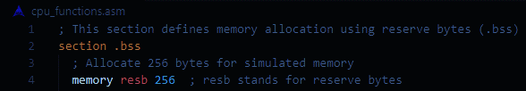
Memory Structure (Memory Array):
Purpose:
Simulates the main memory of the CPU where instructions and data are stored.
Implementation:
Defined as an array in “cpu_functions.asm”.
Accessed by the CPU simulator to read from and write to specific memory addresses.
Role in Execution:
Instructions are fetched from memory based on the program counter (PC).
Data is read from and written to memory by the LOAD and STORE operations.
} /> [

Slide 15
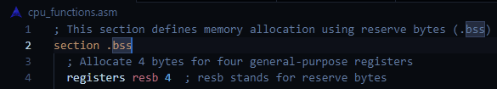
General-Purpose Registers (Registers Array):
Purpose:
Hold intermediate values during instruction execution.
Implementation:
Defined as an array in “cpu_functions.asm”.
Manipulated directly by the CPU simulator to perform arithmetic operations and store results.
Role in Execution:
Registers are used by ADD and SUB operations to perform arithmetic.
Values are loaded into registers from memory and stored back to memory as needed.
} /> [

Slide 16
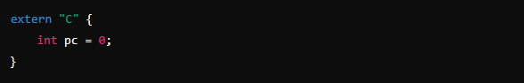
Program Counter (PC):
Purpose:
Ensures sequential execution of instructions in the program.
Implementation:
Declared globally in “cpu_simulator.cpp”.
Role in Execution:
The PC determines the memory address of the next instruction to be fetched from the memory array.
After fetching an instruction, the PC increments to point to the next instruction for subsequent fetches.
} /> [

Slide 17
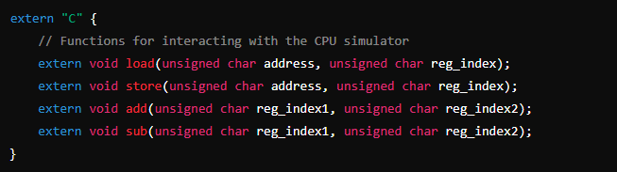
Instruction Set:
Purpose:
Defines the operations that the CPU can perform on data.
Includes fundamental operations like LOAD, STORE, ADD, and SUB.
Implementation:
Defined in “cpu_simulator.cpp”.
Each operation is executed based on the instruction fetched from memory, using the appropriate function to manipulate data in memory or registers.
Role in Execution:
Each instruction corresponds to a specific operation (opcode).
Calls the corresponding assembly function (load, store, add, sub) to execute the operation on data stored in memory or registers.
} /> [

Slide 18
Instruction Execution
04
"Examining how instructions are processed within our CPU simulator."

Slide 19
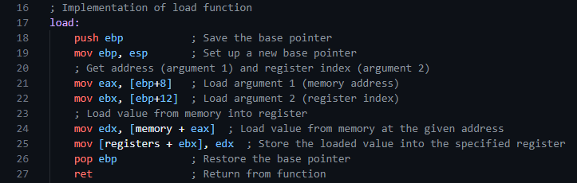
LOAD Instruction
Function:
Operation:
Example:
Loads a value from memory into a specified register.
Retrieves the value stored at a memory address and places it into the designated register.
Instruction: 0x01, 0x01, 0x02
Execution: Load value from memory address 2 into register 1.

Slide 20
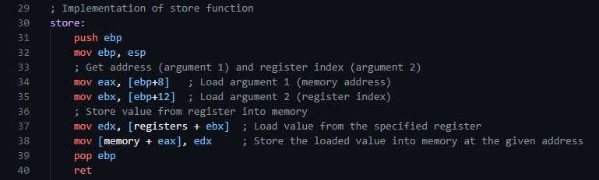
STORE Instruction
Function:
Operation:
Example:
Stores a value from a specified register into memory.
Takes the value from a register and writes it to the memory address provided.
Instruction: 0x02, 0x02, 0x01
Execution: Store value from register 2 into memory address 1.

Slide 21
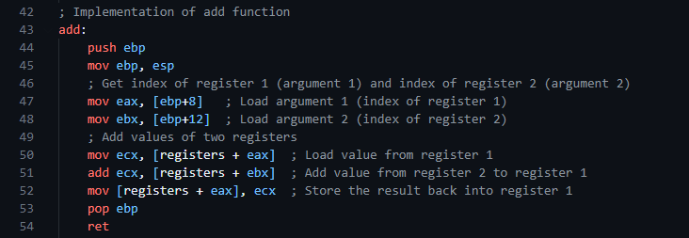
ADD Instruction
Function:
Operation:
Example:
Adds the values from two registers and stores the result in a designated register.
Retrieves values from two registers, performs addition, and stores the result in a specified register.
Instruction: 0x03, 0x01, 0x02
Execution: Add values of registers 1 and 2.

Slide 22
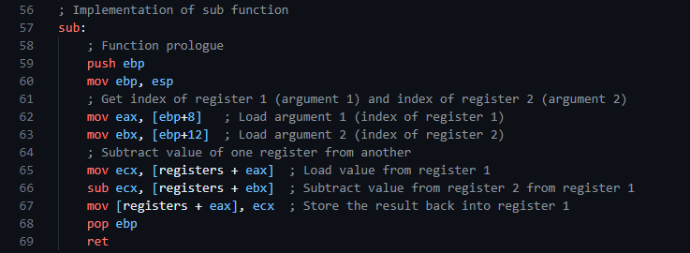
SUB Instruction
Function:
Operation:
Example:
Subtracts the value of one register from another and stores the result in a designated register.
Retrieves values from two registers, performs subtraction, and stores the result in a specified register.
Instruction: 0x04, 0x01, 0x02
Execution: Subtract value of register 2 from register 1.

Slide 23
05
Integration and Execution
"Integrating our components to achieve seamless execution in the simulator."

Slide 24
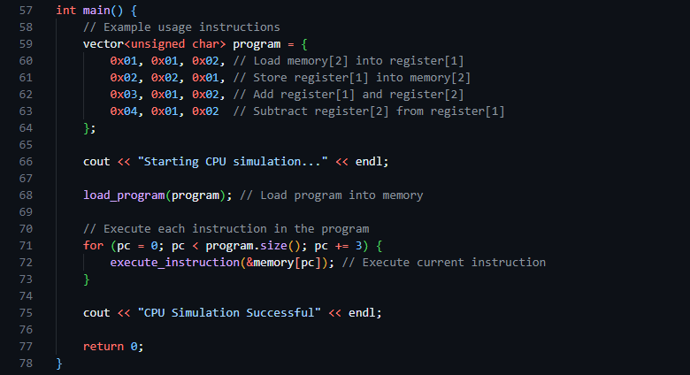
main Function in cpu_simulator.cpp
Purpose: The main function is the entry point of the CPU simulator program. It initializes the program instructions, loads them into memory, and executes them.
Key Steps:
Initialize a vector named ‘program’ which contains example instructions for the CPU simulator.
Print a start message to indicate the beginning of the simulation.
‘load_program’ function copies these instructions into the ‘memory’ array.
Iterate through the instructions, using ‘execute_instruction’ to simulate each one.
Print a success message upon completion.

Slide 25
Loading and Executing Programs
Loading Programs into Memory:
Function: ‘load_program’
Purpose: To copy the contents of a program (instruction set) into the simulated memory array.
Implementation: Uses the ‘memcpy’ function to transfer instructions from the ‘program’ vector to the ‘memory’ array.
Key Point:
‘load_program’ ensures that the program's instructions are accurately copied into the CPU simulator's memory.
Executing Instructions:
Function: ‘execute_instruction’
Purpose: To decode and execute individual instructions based on their opcode.
Implementation: Uses a switch statement to identify and execute the corresponding assembly function (‘load’, ‘store’, ‘add’, ‘sub’).Prints the operation details and operands for each instruction.
Key Points:
‘execute_instruction’ decodes the opcode and calls the appropriate function to perform the operation.
Detailed print statements provide insights into the instruction being executed and its operands, aiding in debugging and understanding the program flow.

Slide 26
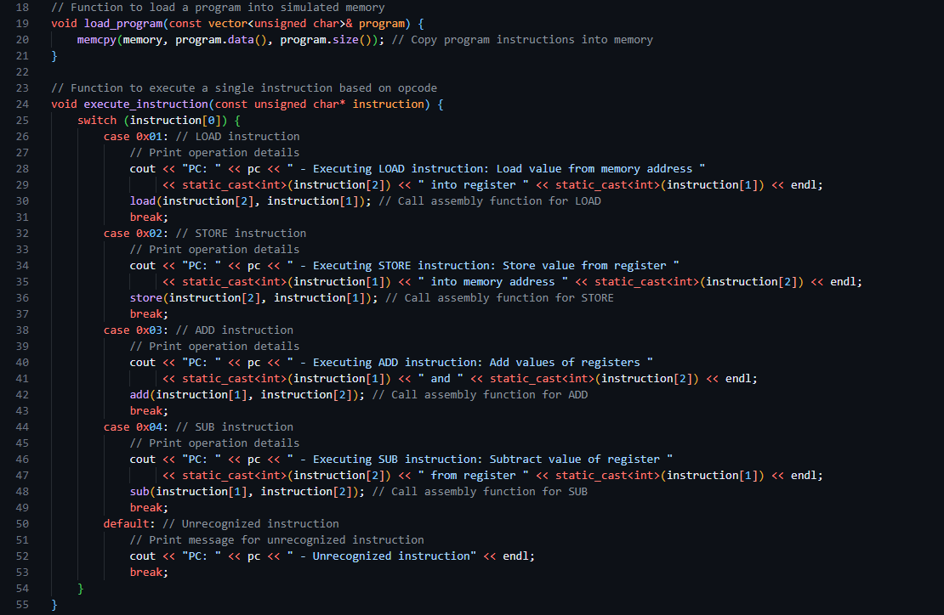
Loading and Executing Programs

Slide 27
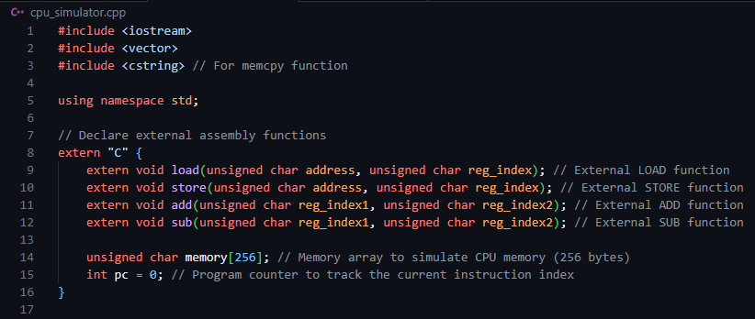
Assembly Interface and External Functions
External Assembly Functions:
Purpose: These functions, declared as extern, interface with the assembly language functions defined in ‘cpu_functions.asm’. They handle the low-level operations of the CPU simulator.
Functions:
‘load’: Loads a value from memory into a register.
‘store’: Stores a value from a register into memory.
‘add’: Adds the values of two registers.
‘sub’: Subtracts the value of one register from another.
Key Points:
‘memory’: A 256-byte array simulating the CPU's main memory.
‘pc’: The program counter, which tracks the index of the current instruction being executed.
Extern “C”: The extern "C" linkage specification prevents name mangling, allowing the C++ code to call the corresponding assembly functions directly, enabling integration between high-level and low-level code.

Slide 28
06
Demonstration
"Witnessing our CPU simulator in action through practical examples."

Slide 29
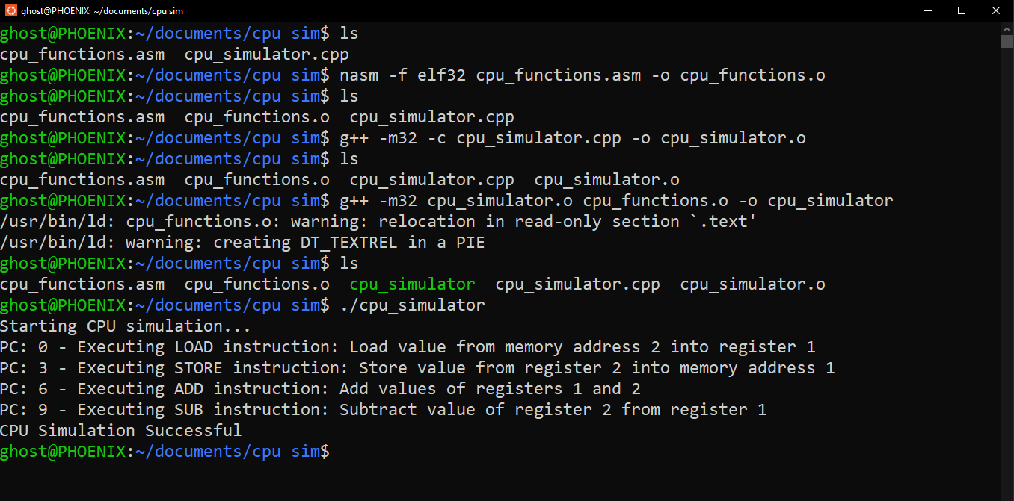
Compilation and Execution Process
The CPU simulator project was compiled and executed on the WSL Ubuntu command line, as shown below.

Slide 30
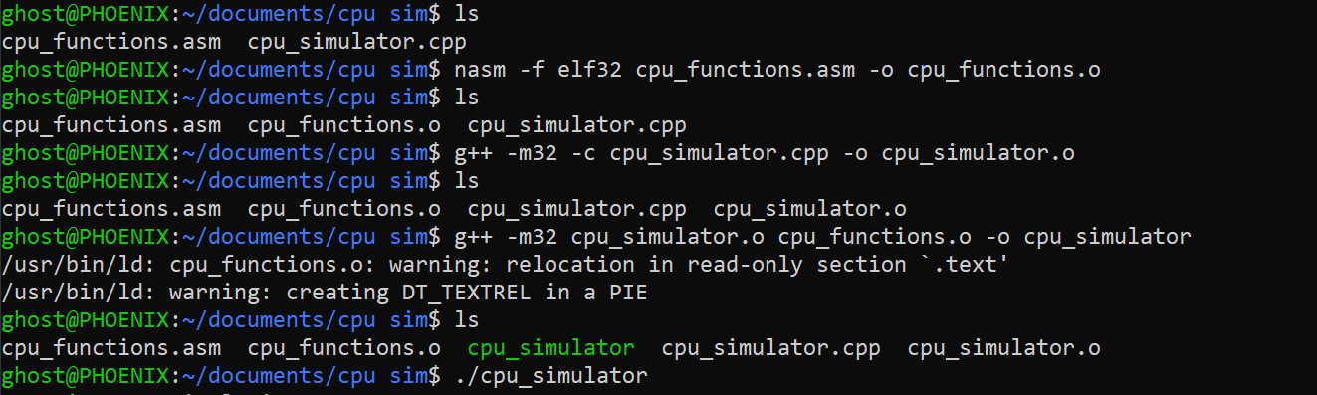
Compiling the Code
} /> [
Command 1:
‘nasm -f elf32 cpu_functions.asm -o cpu_functions.o’
Explanation: This command assembles the cpu_functions.asm file into an object file cpu_functions.o using NASM with the ELF32 format.
Command 2:
‘g++ -m32 -c cpu_simulator.cpp -o cpu_simulator.o’
Explanation: This command compiles the cpu_simulator.cpp file into an object file cpu_simulator.o using the g++ compiler in 32-bit mode.
Command 3:
‘g++ -m32 cpu_simulator.o cpu_functions.o -o cpu_simulator’
Explanation: This command links the two object files cpu_simulator.o and cpu_functions.o to create the executable cpu_simulator using the g++ compiler in 32-bit mode.
Command 1
Command 2
Command 3

Slide 31
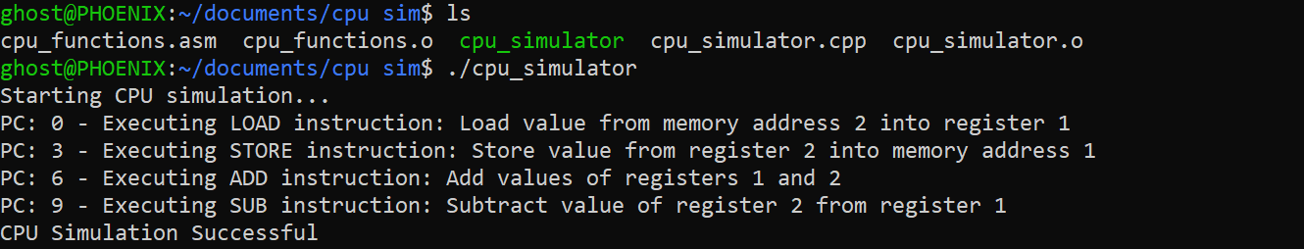
Running the Simulator
} /> [
Command:
./cpu_simulator
Explanation: This command runs the CPU simulator executable.
Output Explanation:
Starting CPU simulation...: Indicates the start of the CPU simulation.
PC: 0 - Executing LOAD instruction...: Shows the program counter (PC) at 0, executing the LOAD instruction.
PC: 3 - Executing STORE instruction...: Shows the PC at 3, executing the STORE instruction.
PC: 6 - Executing ADD instruction...: Shows the PC at 6, executing the ADD instruction.
PC: 9 - Executing SUB instruction...: Shows the PC at 9, executing the SUB instruction.
CPU Simulation Successful: Indicates that the CPU simulation completed successfully.

Slide 32
Conclusion
07
"Reflecting on the outcomes and insights gained from our CPU simulator project."

Slide 33
Achievements and Challenges
Achievements:
Successful Integration of C++ and Assembly:
Effectively combined high-level C++ code with low-level assembly language functions, demonstrating seamless integration.
Functional CPU Simulator:
Developed a fully functional CPU simulator capable of executing basic instructions (LOAD, STORE, ADD, SUB).
Enhanced Understanding of CPU Operations:
Gained a deeper understanding of CPU operations and the interaction between different components (memory, registers, program counter).
Challenges:
Debugging Low-Level Assembly Code:
Debugging assembly code posed significant challenges due to its low-level nature and lack of debugging tools compared to high-level languages.
Ensuring Correctness of Instructions:
Ensuring that each instruction executed correctly required careful planning and testing, especially when handling edge cases and ensuring proper register and memory operations.
Cross-Platform Development:
Developing on a Linux environment using WSL added complexity, requiring careful handling of cross-platform compilation and execution issues.

Slide 34
Thanks!
Do you have any questions?

